Slide 1


APEX INSTITUTE OF TECHNOLOGY
DEPARTMENT OF COMPUTER SCIENCE & ENGINEERING
Computer Organization & Architecture (21CSH-281)
Faculty: Siddharth Kumar (E12853)
Lecture – 23 & 24
Memory Organization: Memory Interleaving &
Concept of Hierarchical Memory Organization
DISCOVER . LEARN . EMPOWER

Slide 2
Computer Organization & Architecture: Course Objectives
COURSE OBJECTIVES
The course aims to:
The purpose of the course is to introduce principles of computer organization and the basic architectural concepts.
It begins with basic organization, design, and programming of a simple digital computer and introduces simple register transfer language to specify various computer operations.
Topics include computer arithmetic, instruction set design, microprogrammed control unit, pipelining and vector processing, memory organization and I/O systems, and multiprocessors.
To familiarize Students with the detailed Architectures of a Central Processing Unit.
Learn the different types of serial communication techniques.

Slide 3
COURSE OUTCOMES
On completion of this course, the students shall be able to:-
CO1 | Identify and interpret the basics of instruction sets and their impact on the design, organization, and functionality of various functional units of a computer comparable to the CPU, memory organization, I/O organization, and parallel processors.
CO2 | Analysis of the design of arithmetic & logic unit and understanding of the fixed point and floating-point arithmetic operations.
CO3 | Relate cost performance and design trade-offs in designing and constructing a computer processor which includes memory.
CO4 | Understanding the different ways of communicating with I/O devices and standard I/O interfaces.
CO5 | Implementation of control unit techniques and the concept of Pipelining.

Slide 4
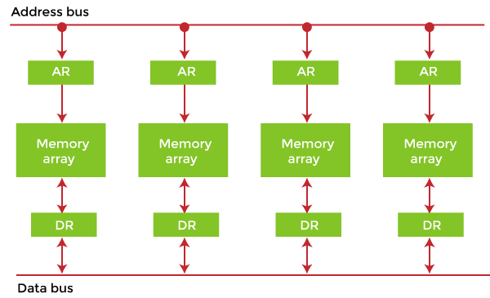
Memory Interleaving
Interleaved memory is designed to compensate for the relatively slow speed of dynamic random-access memory (DRAM) or core memory by spreading memory addresses evenly across memory banks. In this way, contiguous memory reads and writes use each memory bank, resulting in higher memory throughput due to reduced waiting for memory banks to become ready for the operations. It is different from multi-channel memory architectures, primarily as interleaved memory does not add more channels between the main memory and the memory controller.
However, channel interleaving is also possible,
for example, in Freescale i.MX6 processors,
which allow interleaving to be done between two
channels. With interleaved memory, memory addresses
are allocated to each memory bank.

Slide 5
Example of Interleaved Memory
It is an abstraction technique that divides memory into many modules such that successive words in the address space are placed in different modules.
Suppose we have 4 memory banks, each containing 256 bytes, and then the Block Oriented scheme (no interleaving) will assign virtual addresses 0 to 255 to the first bank and 256 to 511 to the second bank. But in Interleaved memory, virtual address 0 will be with the first bank, 1 with the second memory bank, 2 with the third bank and 3 with the fourth, and then 4 with the first memory bank again.
Hence, the CPU can access alternate sections immediately without waiting for memory to be cached. There are multiple memory banks that take turns for the supply of data.
In the above example of 4 memory banks, data with virtual addresses 0, 1, 2 and 3 can be accessed simultaneously as they reside in separate memory banks. Hence we do not have to wait to complete a data fetch to begin the next operation.

Slide 6
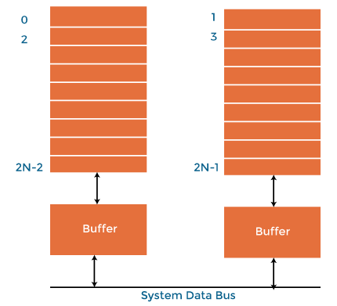
An interleaved memory with n banks is said to be n-way interleaved. There are still two banks of DRAM in an interleaved memory system, but logically, the system seems one bank of memory that is twice as large.
In the interleaved bank representation below with 2 memory banks, the first long word of bank 0 is flowed by that of bank 1, followed by the second long word of bank 0, followed by the second long word of bank 1 and so on.
The following image shows the organization of two physical banks
of n long words. All even long words of the logical bank are located
in physical bank 0, and all odd long words are located in physical
bank 1.

Slide 7
Why do we use Memory Interleaving?
When the processor requests data from the main memory, a block (chunk) of data is transferred to the cache and then to processor. So whenever a cache miss occurs, the data is to be fetched from the main memory. But main memory is relatively slower than the cache. So to improve the access time of the main memory, interleaving is used.
For example, we can access all four modules at the same time, thus achieving parallelism. The data can be acquired from the module using the higher bits. This method uses memory effectively.
Types of Interleaved Memory
In an operating system, there are two types of interleaved memory, such as:
1. High order interleaving: In high order memory interleaving, the most significant bits of the memory address decides memory banks where a particular location resides. But, in low order interleaving the least significant bits of the memory address decides the memory banks.

Slide 8
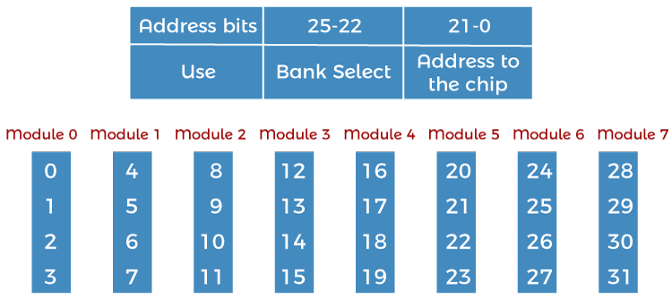
The least significant bits are sent as addresses to each chip. One problem is that consecutive addresses tend to be in the same chip. The maximum rate of data transfer is limited by the memory cycle time. It is also known as Memory Banking.
2. Low order interleaving: The least significant bits select the memory bank (module) in low-order interleaving. In this, consecutive memory addresses are in different memory modules, allowing memory access faster than the cycle time.

Slide 9
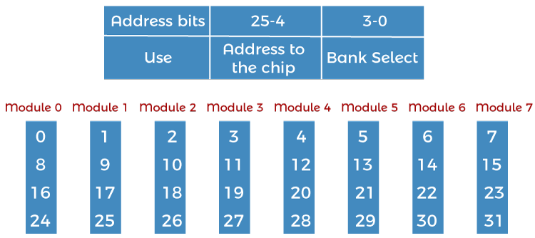
Benefits of Interleaved Memory
An instruction pipeline may require instruction and operands both at the same time from main memory, which is not possible in the traditional method of memory access.
Similarly, an arithmetic pipeline requires two operands to be fetched simultaneously from the main memory.

Slide 10
So, to overcome this problem, memory interleaving comes to resolve this.
It allows simultaneous access to different modules of memory. The modular memory technique allows the CPU to initiate memory access with one module while others are busy with the CPU in reading or write operations. So, we can say interleave memory honors every memory request independent of the state of the other modules.
So, for this obvious reason, interleave memory makes a system more responsive and fast than non-interleaving. Additionally, with simultaneous memory access, the CPU processing time also decreases and increasing throughput. Interleave memory is useful in the system with pipelining and vector processing.
In an interleaved memory, consecutive memory addresses are spread across different memory modules. Say, in a byte-addressable 4 way interleave memory, if byte 0 is in the first module, then byte 1 will be in the 2nd module, byte 2 will be in the 3rd module, byte 3 will be in the 4th module, and again byte 4 will fall in the first module, and this goes on.

Slide 11
An n-way interleaved memory where main memory is divided into n-banks and system can access n operands/instruction simultaneously from n different memory banks.
This kind of memory access can reduce the memory access time by a factor close to the number of memory banks. In this memory interleaving memory location, i can be found in bank i mod n.
Interleaving DRAM
Main memory is usually composed of a collection of DRAM memory chips, where many chips can be grouped together to form a memory bank. With a memory controller that supports interleaving, it is then possible to layout these memory banks so that the memory banks will be interleaved.
Data in DRAM is stored in units of pages. Each DRAM bank has a row buffer that serves as a cache for accessing any page in the bank. Before a page in the DRAM bank is read, it is first loaded into the row-buffer.
If the page is immediately read from the row-buffer, it has the shortest memory access latency in one memory cycle. Suppose it is a row buffer miss, which is also called a row-buffer conflict.

Slide 12
It is slower because the new page has to be loaded into the row-buffer before it is read.
Row-buffer misses happening as access requests on different memory pages in the same bank are serviced.
A row-buffer conflict incurs a substantial delay for memory access.
In contrast, memory accesses to different banks can proceed in parallel with high throughput.
In traditional layouts, memory banks can be allocated a contiguous block of memory addresses, which is very simple for the memory controller and gives an equal performance in completely random access scenarios compared to performance levels achieved through interleaving.
However, memory reads are rarely random due to the locality of reference, and optimizing for close together access gives far better performance in interleaved layouts.
The way memory is addressed does not affect the access time for memory locations that are already cached, impacting only on memory locations that need to be retrieved from DRAM.

Slide 13
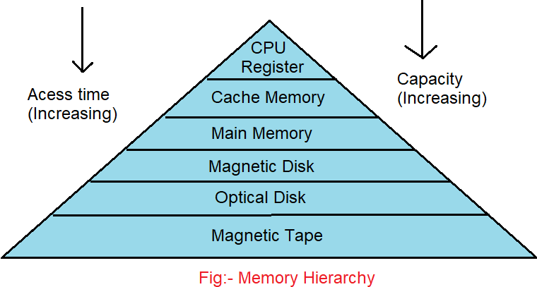
Concept of Hierarchical Memory Organization
In our computer system, a processor and many memory devices have been used. However, the main problem is these devices are expensive. So the memory organization of the system is done with the help of the memory hierarchy.
It has various levels of memory with different access times and performance rates. But all these can give us an exact purpose, such that the access time can be reduced. Therefore the memory hierarchy was developed based on the program.
We will discuss the Memory organization or Hierarchy of computer architecture in detail.
What is Memory Hierarchy?

Slide 14
The memory hierarchy is the arrangement of various types of storage on a computing system based on access speed. It organizes computer storage according to response time.
Since response time, complexity, and capacity are all connected, the levels can also be distinguished by their performance and controlling technologies.
As shown in the above picture, the computer memory has a pyramid-like structure. It is used to describe the different levels of memory.
It separates the computer storage based on hierarchy.
As you can see, capacity is increasing with time. This Memory Hierarchy Design is divided into 2 types:
•Primary or internal memory: It consists of CPU registers, Cache Memory, Main Memory, and these are directly accessible by the processor.
•Secondary or external memory: It consists of a Magnetic Disk, Optical Disk, Magnetic Tape, which are accessible by processor via I/O Module.

Slide 15
Let's focus on each memory level in detail to better understand the topic.
Memory Hierarchy Design
The Memory hierarchy is further classified into two types:
Internal memory: It is also called primary memory. Internal memory is a part of your computer that, when running, can store small amounts of data that need to be accessed quickly. This type of memory is directly reachable by the process through the I/O module. It consists of RAM, ROM, and cache memory.
• RAM: It is a volatile memory that is used to store whatever is in use by the computer, and it acts as a middle man between the CPU and the storage device, which helps speed up the computer. It has many forms, but the most common type is DDR3.
• ROM: ROM, unlike other internal memory, is non-volatile. ROM stands for read-only memory, meaning the user cannot write data to the ROM without special access. It was designed so that the computer could access the bios without other parts of hardware.
• Cache: It is a really small, super-fast memory found in various computer components. The CPU cache stores small bits of frequently accessed data from the RAM so that the processor doesn't have to wait for the RAM to respond every time it wants the same piece of information.

Slide 16
External memory: It is also known as secondary memory. Since it has a huge capacity, it stores massive data. Presently, it can measure the data in hundreds of megabytes or even in gigabytes. The critical property of external memory is that stored information will not be lost whenever the computer switches off. It consists of magnetic tape, a magnetic disk, and an optical disk.
• Magnetic tape: It is a medium for magnetic storage, a thin, magnetizable coating on a long, narrow strip of plastic film. It is used for many purposes like hanging signs and displays for business recording audio in a recording tape to store the data on a hard disk. Alternatively, we can use it for keeping things in a house or a garage.
• Magnetic disk: Magnetic disks are flat circular plates of metal or plastic coated on both sides with iron oxide. Input signals, which may be audio, video, or data, are recorded on the surface of a disk as magnetic patterns or spots in spiral tracks by a recording head while a drive unit rotates the disk. It is relatively cheap per storage unit, with Fast access and retrieval times compared to other storage devices.
• Optical disk: It is an electronic data storage medium that can be written to and read using a low-powered laser beam. Optical disks are often stored in exceptional cases, sometimes called jewel cases, and are most commonly used for digital preservation, music, video, or data and programs for personal computers. Optical media provides many advantages for storing data over conventional magnetic disks, such as mass storage capacity, mountable/unmountable storage units, and low cost per bit of storage.

Slide 17
Characteristics of Memory Hierarchy
The memory characteristics mainly include:
1. Access Time: The access time in the memory hierarchy of a computer system is the interval of the time among the data availability and request to read or write.
2. Capacity: It is the amount of information that can be stored. The capacity increases as we move from top to bottom in the hierarchy.
3. Performance: In old times, designing a computer system was done without memory hierarchy. The gap of speed between the main memory and the CPU registers is enhanced because of the huge inconsistency in access time, which will cause the lower performance of the system. So, the enhancement in the memory was mandatory. This enhancement was designed in the memory hierarchy model due to the system's performance increase.
4. Cost per bit: As we will move from bottom to top in the system's hierarchy, the cost per bit increases, i.e., Internal Memory is costlier than External Memory.

Slide 18
Advantages
Removes external destruction.
Swapping will be more proficient.
Data can be spread all over.
Memory distribution is simple and economical

Slide 19
Summary
Why do we need a computer memory?
Discussed about the Memory interleaving.
Discussed about memory hierarchy?
Assessment Questions
Q1. Why is memory hierarchy?
Q2. What are the types of memory hierarchy?

Slide 20

THANK YOU

